Slide 1

Western GOA Pcod assessment research
September 2025 Plan Team

Slide 2
Outline
Combined tagging data
Fishery characteristics
Survey index comparison
Brainstorming apportionment options
Discussion

Slide 3
Combined tagging data
Collated all available tagging data
Includes both conventional and satellite tags (using only release/pop-off locations)
Starts in 1982, total of 2,879 tags
Filter to:
At least 30 days at liberty
Released-recovered in EBS|NBS, WGOA, and CGOA
 | Release region
 | EBS|NBS | WGOA | CGOA
Pre-2020 | 2,051 | 132 | 453
Post-2020 | 37 | 139 | 67
Total | 2,088 | 271 | 520

Slide 4
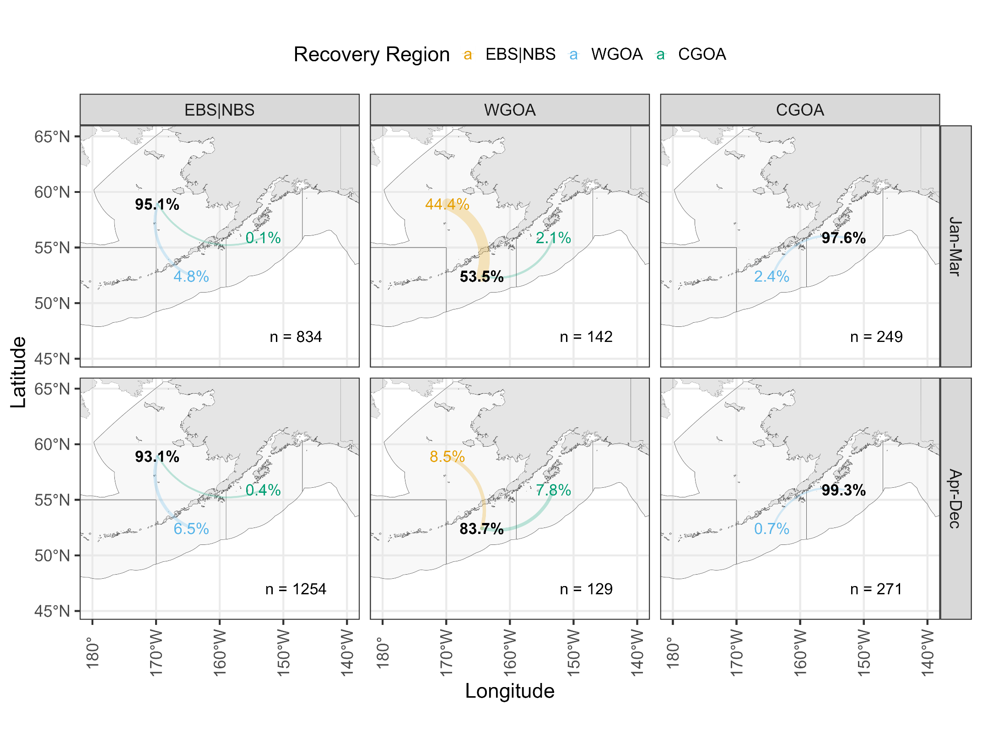

Slide 5
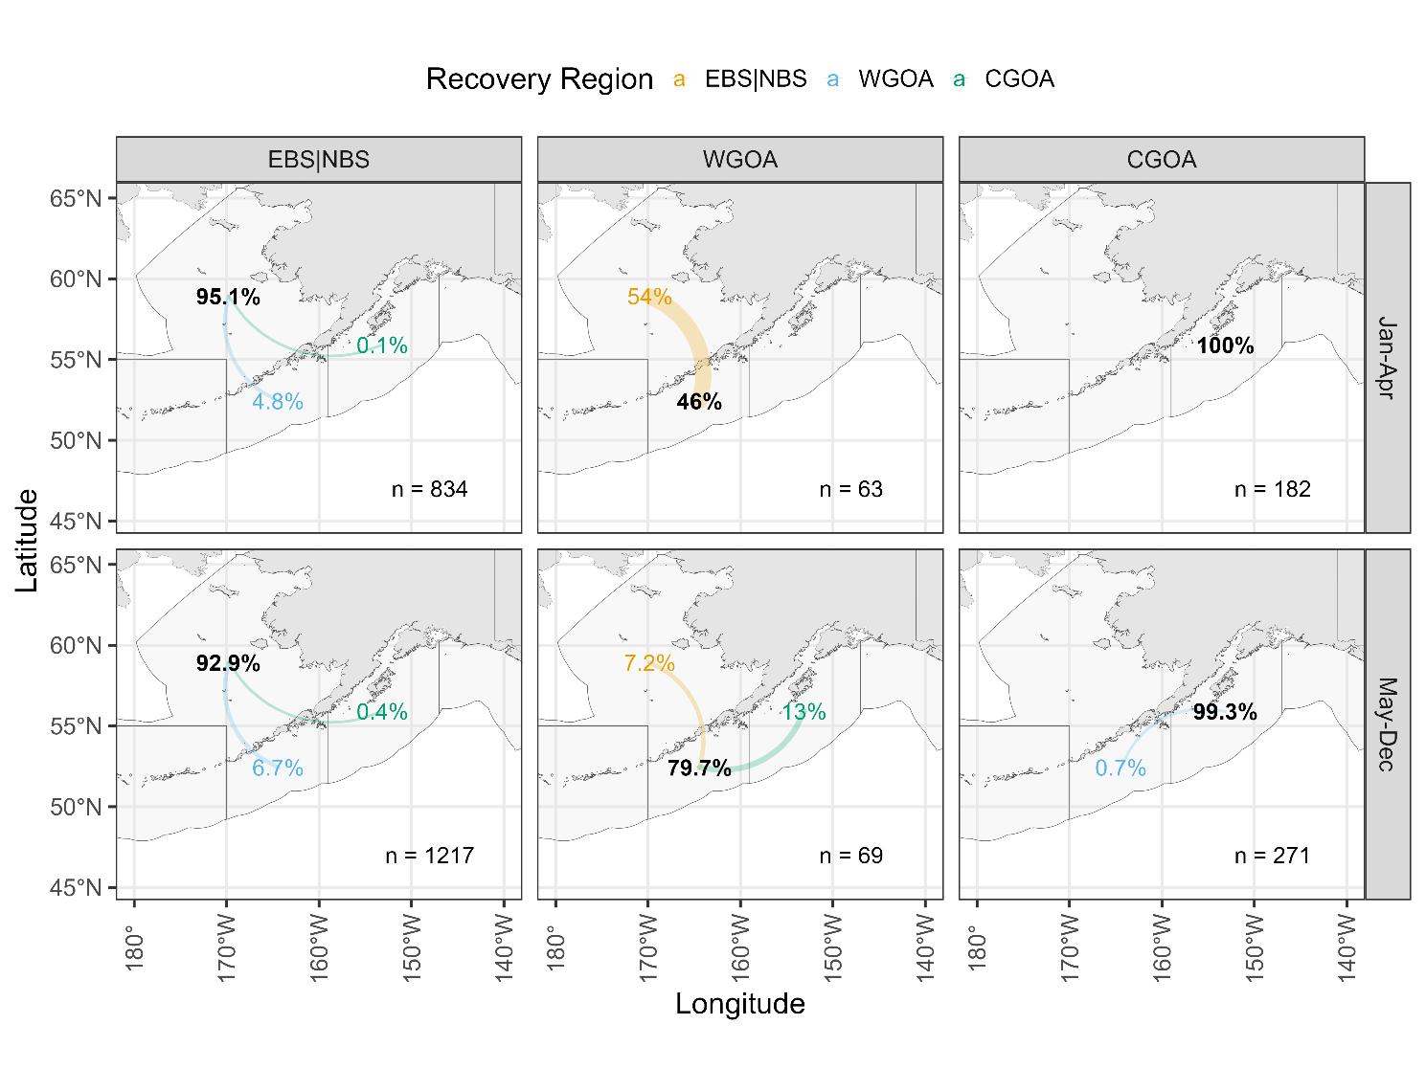
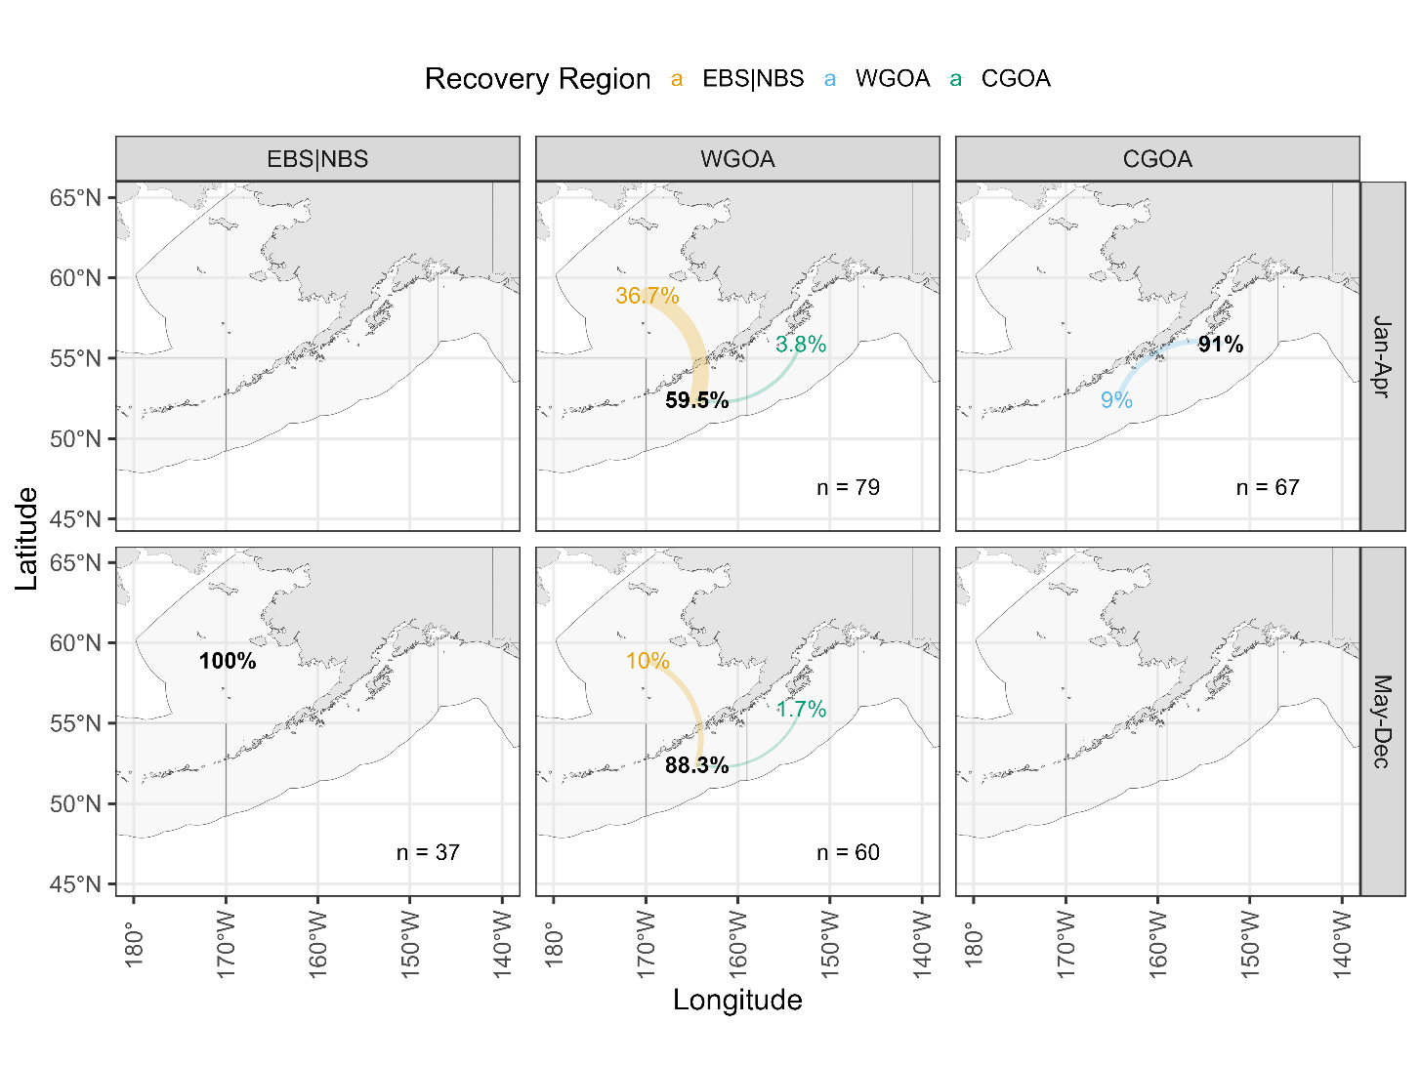
Pre-2020
Post-2020

Slide 6
Combined tagging data
Why Jan-Mar? Seasonality of movement from WGOA:
 | From WGOA, to…
Month | EBS|NBS | WGOA | CGOA | n
1 | 33% | 67% | 0% | 42
3 | 49% | 48% | 3% | 100
4 | 12% | 86% | 2% | 50
5 | 0% | 100% | 0% | 3
6 | 0% | 100% | 0% | 2
7 | 4% | 96% | 0% | 23
8 | 9% | 73% | 18% | 45
9 | 0% | 83% | 17% | 6
All | 27% | 68% | 5% | 271

Slide 7
Combined tagging data
Seasonality of movement from EBS|NBS:
 | From EBS|NBS, to…
Month | EBS|NBS | WGOA | CGOA | n
1 | 84% | 16% | 0.0% | 19
2 | 95% | 5% | 0.1% | 809
3 | 100% | 0% | 0.0% | 6
4 | 94% | 6% | 0.0% | 678
6 | 90% | 7% | 2.8% | 71
7 | 96% | 4% | 0.0% | 82
8 | 94% | 6% | 0.0% | 108
9 | 94% | 6% | 0.7% | 141
10 | 84% | 12% | 4.0% | 25
11 | 90% | 9% | 0.7% | 149
All | 94% | 6% | 0.3% | 2088

Slide 8
Combined tagging data
Take homes:
WGOA has largest amount of movement out of the region as compared to EBS|NBS and CGOA
Strong seasonal component, bulk of movement from WGOA to EBS|NBS occurs prior to April
Recent tagging has less movement to EBS|NBS (~37%) as compared to historical tagging data (~54%) prior to April
EBS|NBS movement to WGOA consistent across month/season, and hovers ~6%
CGOA has limited movement to WGOA, none to EBS|BS

Slide 9
Fishery characteristics
Catch from Cod-targeted trips by season:
 |  | Jan-Mar | Apr-Dec
610 | Pre-closure | 83% | 17%
 | Post-closure | 82% | 18%
620 | Pre-closure | 76% | 24%
 | Post-closure | 65% | 35%
630 | Pre-closure | 77% | 23%
 | Post-closure | 72% | 28%

Slide 10
Fishery characteristics
WGOA catch from Cod-targeted trips by gear and season since 2020:
 | Jan-Mar | Apr-Dec | % of total catch
Pot | 95% | 5% | 52%
Trawl | 97% | 3% | 24%
Longline | 45% | 55% | 19%
Jig | 19% | 81% | 5%

Slide 11
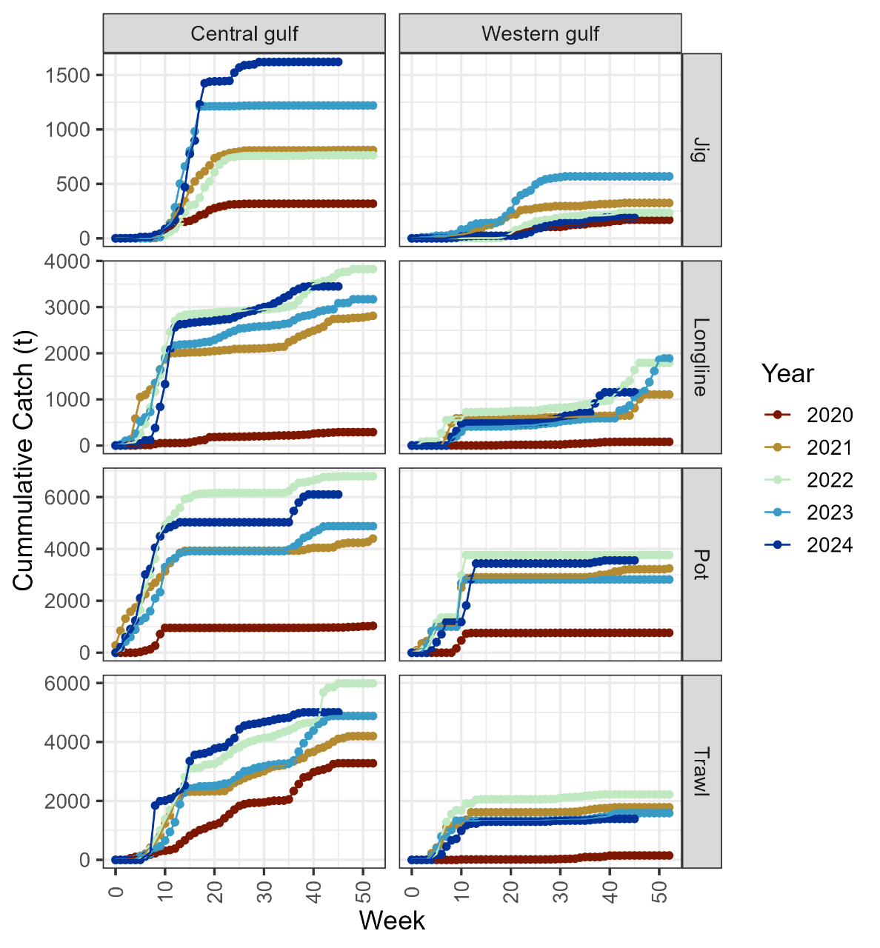
Fishery characteristics
Take home:
Majority of cod-targeted catch in the WGOA and CGOA is landed prior to April, with larger proportion in the WGOA
Within WGOA, this holds particularly for Pot and Trawl
This coincides within the time period when EBS|NBS fish are in the WGOA
Likely that presence of cod in Jan-Mar not the limiting factor for catch in the WGOA

Slide 12
Survey index comparison
Purpose is to provide context of how large a proportion of biomass we see in the survey/summer is in the WGOA compared to the EBS|NBS
sdmTMB used to estimate model-based indices for EBS|NBS and WGOA
Provides annual estimates of survey biomass that integrates EBS-NBS surveys for comparison with survey in WGOA

Slide 13
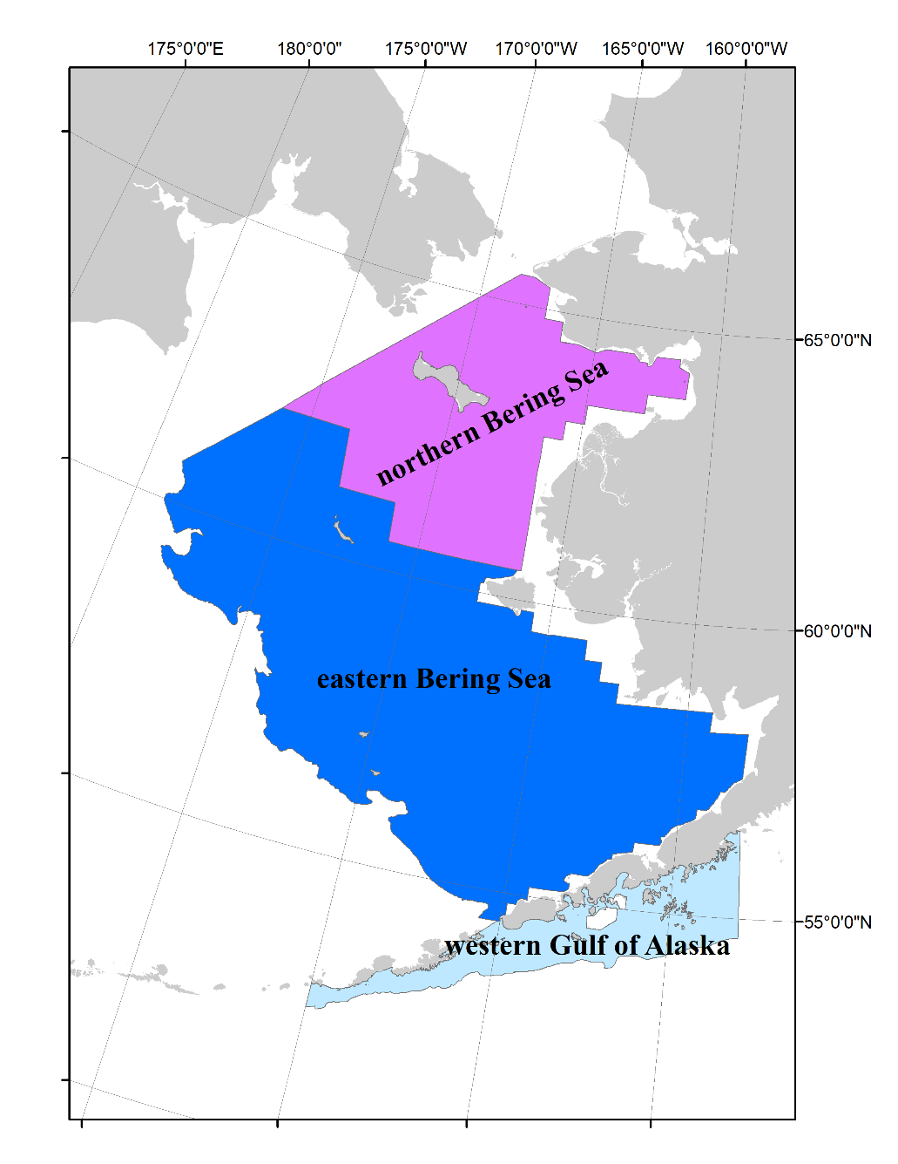
Survey index comparison
Map of region:
WGOA not quite aligned with current management areas
Adjusted based on spatial fishery catch, tagging data, and bathymetry
So, not precisely same as current WGOA biomass used in apportionment, but close enough to provide comparisons

Slide 14
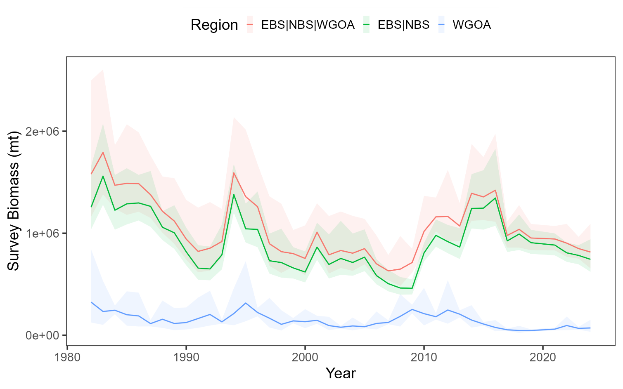
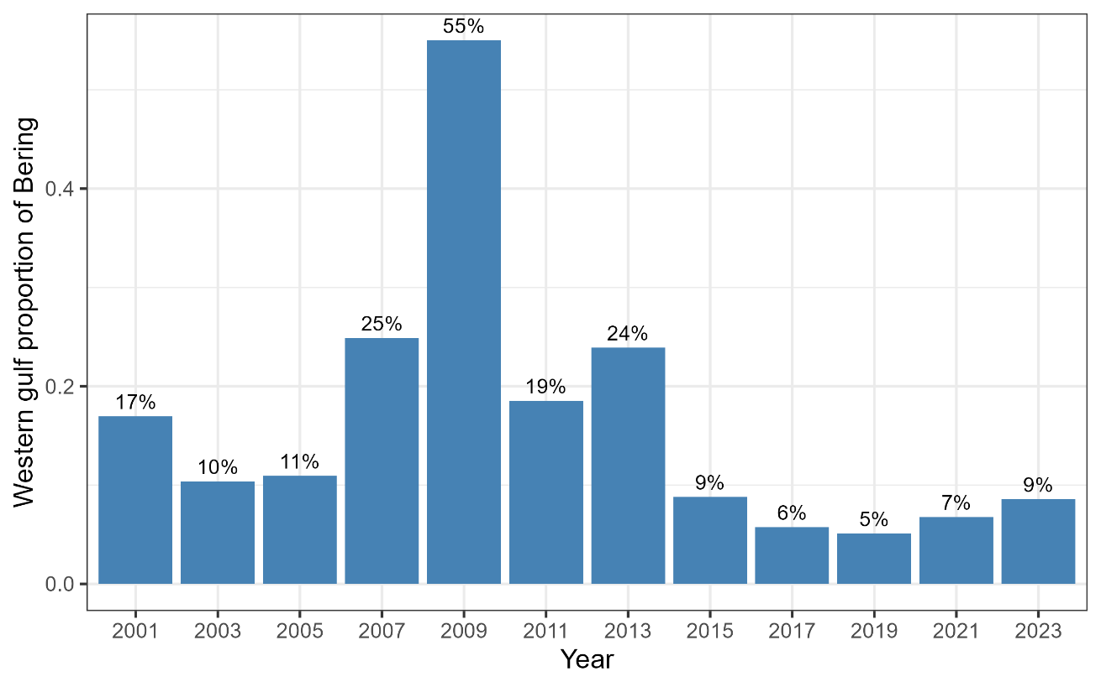
Survey index comparison

Slide 15
Survey index comparison
Proportion of survey biomass in WGOA as compared to EBS|NBS is variable, and can be large depending on relative regional biomass
In recent years (post-2015) WGOA biomass is around 5-9% of EBS|NBS biomass, and has increased in the last 3 surveys

Slide 16
Brainstorming apportionment options
Range of options, from complex to simple:
Spatially and seasonally-explicit model that estimates movement
Single area BS|WGOA integrated model (w or w/o seasonality)
Ad hoc adjustment to current methodology informed by tagging
Weigh benefits and risks involved with each
Things to keep in mind from previous presentations/discussion:
There is a seasonal component to movement from the WGOA to the BS
There is evidence of migratory and resident populations in WGOA
Fishery largely operates seasonally as well
Our current system is conservative in the WGOA, a change to adjust BRD will involve increasing risk at some level

Slide 17
Brainstorming apportionment options
Range of options, from complex to simple:
Spatially and seasonally-explicit model that estimates movement
Single area BS|WGOA integrated model (w or w/o seasonality)
Ad hoc adjustment to current methodology informed by tagging
Benefits:
Would provide regional and seasonal estimates of abundance, from which projections of catch can be determined
Provides a framework to estimate and understand movement between the WGOA and BS
Would provide an assessment model that aligns with the biological attributes of the WGOA and BS stock

Slide 18
Brainstorming apportionment options
Range of options, from complex to simple:
Spatially and seasonally-explicit model that estimates movement
Single area BS|WGOA integrated model (w or w/o seasonality)
Ad hoc adjustment to current methodology informed by tagging
Risks:
Extremely data hungry. The biggest hole we have in this type of model is a lack of seasonal index data (i.e., we don’t know the abundance in the WGOA during winter/spawning), we also have limited amount of tagging data to inform movement, which is likely driven to a great extent by environmental/ecosystem influences
To make this type of model run with our available data, will need to make a large number of assumptions, for example, fixing movement and other key parameters

Slide 19
Brainstorming apportionment options
Range of options, from complex to simple:
Spatially and seasonally-explicit model that estimates movement
Single area BS|WGOA integrated model (w or w/o seasonality)
Ad hoc adjustment to current methodology informed by tagging
Benefits:
Would provide assessment model that aligns with what we understand to be the biological distribution/connectivity between the BS and WGOA stock
Would look very similar to the models we currently use now, would simply be adding survey/fishery data between regions
Note: we have this model in development (Steve will talk about soon)

Slide 20
Brainstorming apportionment options
Range of options, from complex to simple:
Spatially and seasonally-explicit model that estimates movement
Single area BS|WGOA integrated model (w or w/o seasonality)
Ad hoc adjustment to current methodology informed by tagging
Risks:
Would not have regional estimates of abundance
The BS data within this model dominates estimates
Would need to develop some sort of apportionment method that (1) provides BRDs, and (2) accounts for seasonality of abundance in WGOA
A large risk here is to not overharvest a summer-resident population within the WGOA from a model that essential swamps out any signal from the WGOA data

Slide 21
Brainstorming apportionment options
Range of options, from complex to simple:
Spatially and seasonally-explicit model that estimates movement
Single area BS|WGOA integrated model (w or w/o seasonality)
Ad hoc adjustment to current methodology informed by tagging
Benefits:
Would continue to utilize assessment framework that is well understood by managers/stakeholders
Could provide a simple approach to adjusting BRD between the BS and WGOA

Slide 22
Brainstorming apportionment options
Range of options, from complex to simple:
Spatially and seasonally-explicit model that estimates movement
Single area BS|WGOA integrated model (w or w/o seasonality)
Ad hoc adjustment to current methodology informed by tagging
Risks:
Doesn’t explicitly address the biology/distribution of the BS and WGOA stock through a model
Would need to make an assumption about the movement rate between WGOA and BS

Slide 23
Brainstorming apportionment options
Range of options, from complex to simple:
Spatially and seasonally-explicit model that estimates movement
Single area BS|WGOA integrated model (w or w/o seasonality)
Ad hoc adjustment to current methodology informed by tagging
Simple example to get a feel for what magnitude we’re talking about:
Say X% is the movement rate of WGOA to BS from Jan-Mar, W is biomass in WGOA, and B is the biomass in the BS (use survey biomass in example)
The word problem: If X% of cod move from the WGOA, leaving W that is observed behind, what percent of the BS biomass B surveyed in the summer moved from the WGOA?
Answer: the proportion of biomass in the BS that moved from the WGOA would be X%∙W / B

Slide 24
Brainstorming apportionment options
Range of options, from complex to simple:
Spatially and seasonally-explicit model that estimates movement
Single area BS|WGOA integrated model (w or w/o seasonality)
Ad hoc adjustment to current methodology informed by tagging
Simple example to get a feel for what magnitude we’re talking about:
% of BS biomass | Movement rate from WGOA
% of BS biomass | 30% | 40% | 50%
2019 | 2.2% | 3.4% | 5.1%
2021 | 2.9% | 4.5% | 6.7%
2023 | 3.7% | 5.7% | 8.6%
Avg | 2.9% | 4.5% | 6.8%

Slide 25
Discussion
Strong seasonal component to movement from WGOA to EBS|NBS
Any upward adjustment to WGOA BRD involves risk to a resident WGOA stock
Indication that abundance is larger in WGOA from Jan-Mar than observed in the survey
Multiple methods being evaluated to ultimately enable adjustment of WGOA/EBS|NBS BRDs
Main take homes:
Any upward adjustment of WGOA BRD would need to be allocated to a Jan-Mar fishery in the WGOA
Whatever model or method we use, we will need to make strong assumptions on movement or other key parameters

